Slide 1

Ticket Classification
Capstone Project
Team: Mokshada Joshi, Mukesh Joshi, and Subhash Kumar

Slide 2
Business Motivation
Automating ticket assignment process to reduce response time for customer queries.
Targeting a reduction in first effective response time by 18 hours on average.
Utilizing data-driven approaches to classify customer tickets accurately.
Leveraging the dataset from the customer support desk for analysis and modelling.
Improving overall customer satisfaction by resolving queries more efficiently.
Enhancing operational efficiency and resource utilization within the bank.
Streamlining communication channels between customers and relevant stakeholders.
Potentially reducing workload and stress on support staff by automating ticket assignments.
Aim for cost savings through improved efficiency and reduced manual intervention.

Slide 3
Approach
The entire work has been approached in three tasks:
Task 1: Data Understanding
Task 2: Feature Engineering
Task 3: Modelling
Task 4: Deployment

Slide 4
Task 1: Data Understanding

Slide 5
Data Understanding
Number of labelled customer complaints: 400

Slide 6
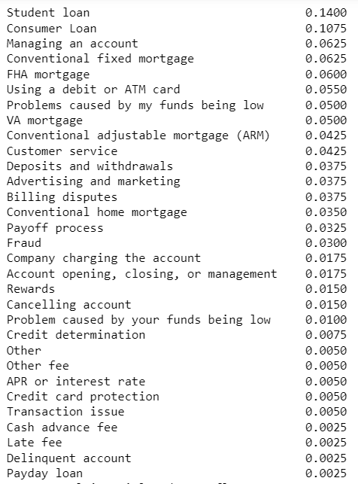
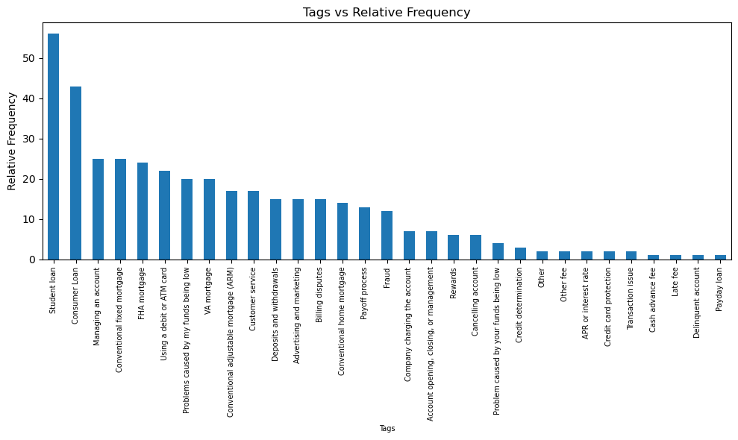
Data Understanding
Tags
Frequency
Relative frequency of tags in the dataset

Slide 7
Data Understanding
Checking for encoding issues:
File read successfully with encoding: utf-8
File read successfully with encoding: latin1
Error reading file with encoding utf-16: 'utf-16-le' codec can't decode byte 0x0a in position 287344: truncated data
File read successfully with encoding: iso-8859-1

Slide 8
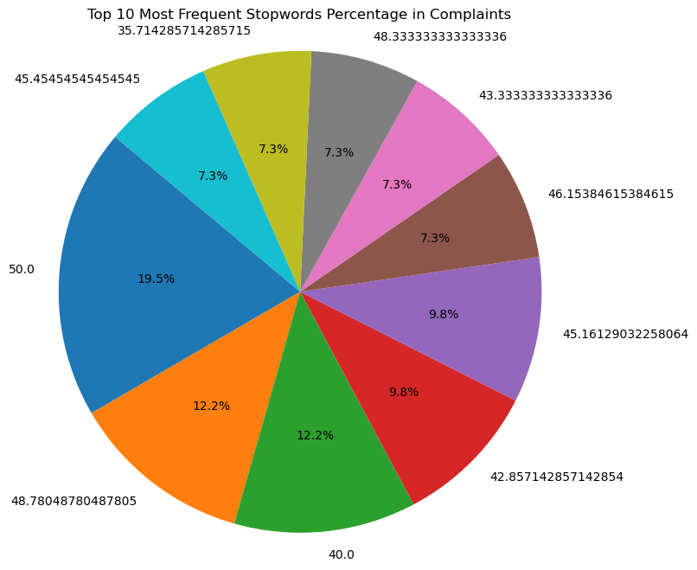
Data Understanding
Stopwords in each complain:
Minimum stopwords %: 29.0%
Maximum stopwords %: 50.0%
Mean stopwords %: 37.815%

Slide 9
Task 2: Feature Engineering

Slide 10
FEATURE ENGINEERING
Count matrix or a tf-idf matrix
Shape of TF-IDF matrix: (400, 3772)

Slide 11
FEATURE ENGINEERING
Count matrix or a tf-idf matrix
Adding other features apart from TF-IDF matrix: 1. Sentiment Score and 2. Sentiment Level

Slide 12
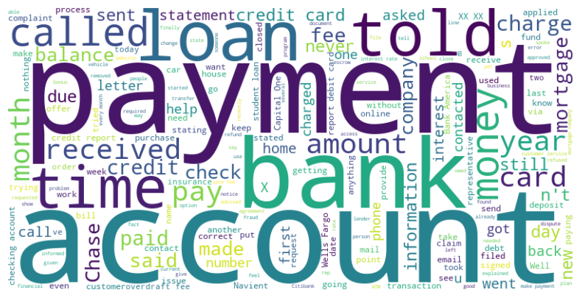
FEATURE ENGINEERING
Sentiment analysis: Creating Word Clouds to visualize the most frequent words in complaints
As per Unigram analysis, data revolve around Payment, Account, Loan

Slide 13
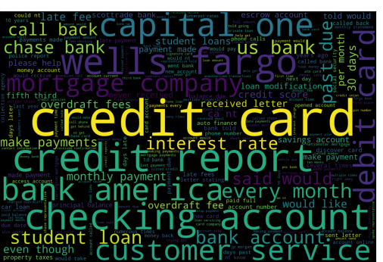
FEATURE ENGINEERING
Sentiment analysis: Creating Word Clouds to visualize the most frequent words in complaints
As per Bigram analysis, data revolve around Credit Card, Credit report, Checking account

Slide 14
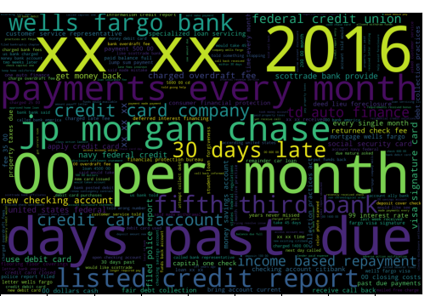
FEATURE ENGINEERING
Sentiment analysis: Creating Word Clouds to visualize the most frequent words in complaints
As per Trigram analysis, data revolve around xx xx 2016, 00 per month, jp morgan chase

Slide 15
Task 3: MODELING

Slide 16
Model building
Models explored to create a ticket classification system are:
Naive Bayes
Linear Classifier
SVM
Tree-based ensembles
KNN
Bert Sequence Classifier

Slide 17
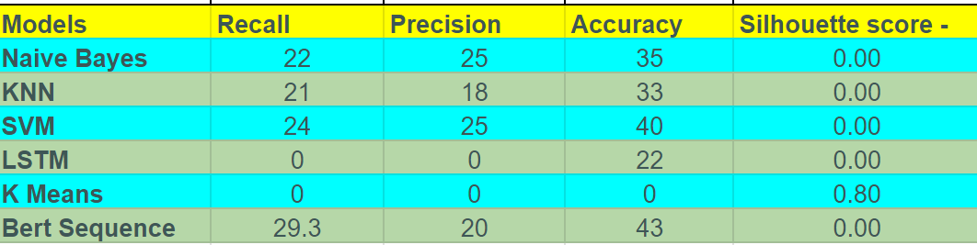
Model building
Model Performance Evaluation
As per the model performance matrix, the Bert Sequence Classifier shows the highest accuracy.

Slide 18
Model building
Remarks on Model Performance Evaluation:
The aim of the project is to provide an initial insight into the category of the complaint received.
Here, the size of the data set is only 400 rows. So, to have better results more data points are required.

Slide 19
Task 4: Model Deployment

Slide 20
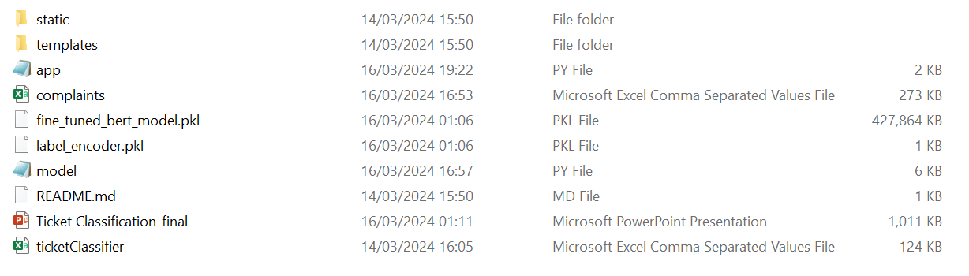
prediction module Directory

Slide 21
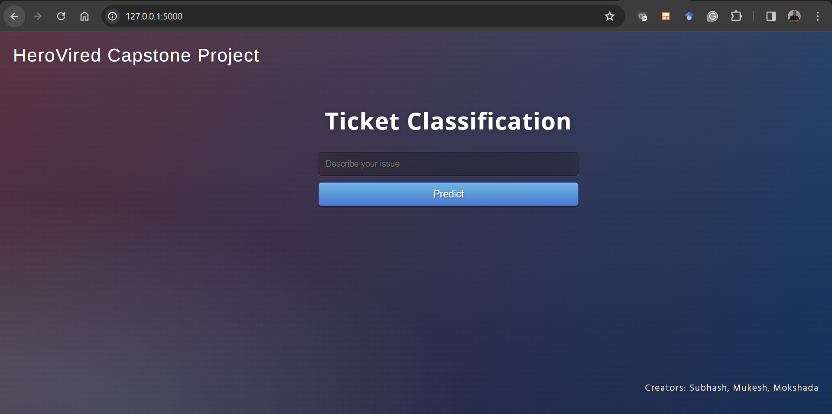
Local Host for checking specific complaints

Slide 22
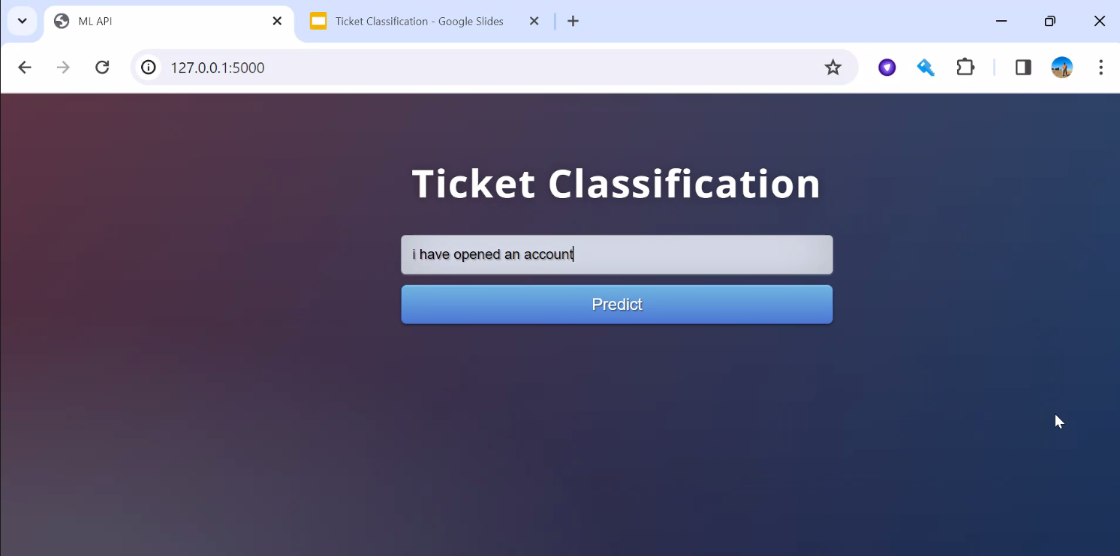
Entering complaints in Ticket classification Check box

Slide 23
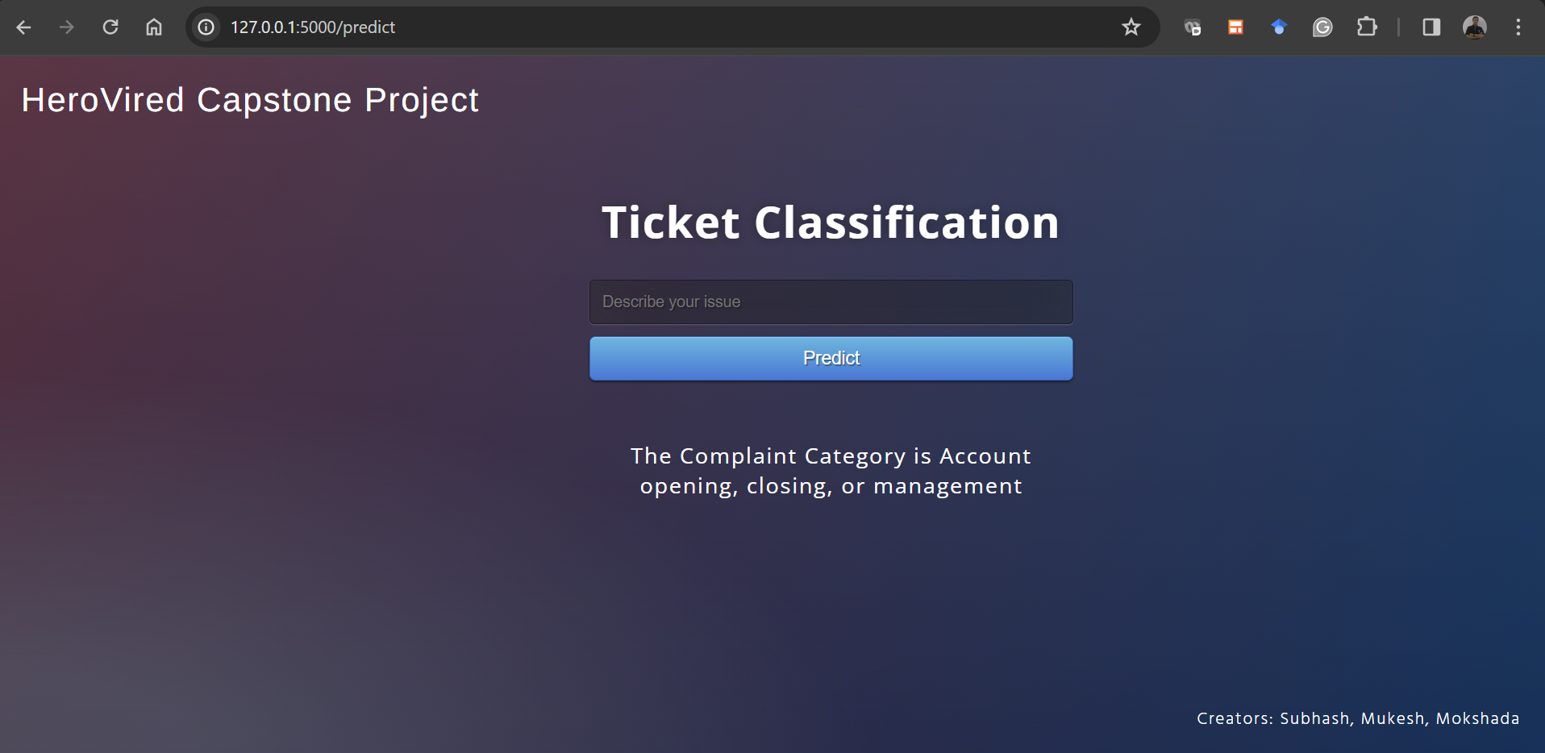
Predicting type of Complaint

Slide 24



Thank You!

